Slide 1
Introduction to Web Scraping with Python
Utilizing Selenium and Beautiful Soup
By: Clayton Hodges
11/28/23

Slide 2

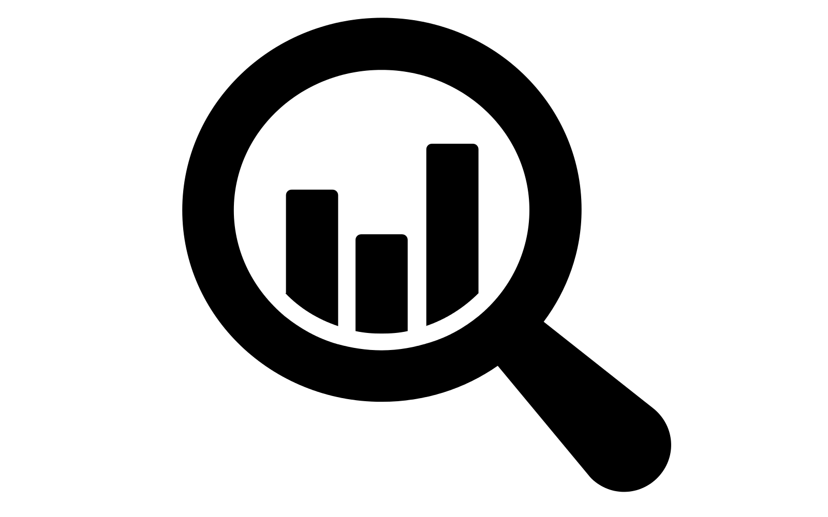
What is Web Scraping?
Web scraping is the process of extracting data from websites. It involves programmatically visiting websites and extracting useful information.
It’s a powerful tool that’s traditionally used for data analysis and market research.
This Photo by Unknown Author is licensed under CC BY-SA

Slide 3
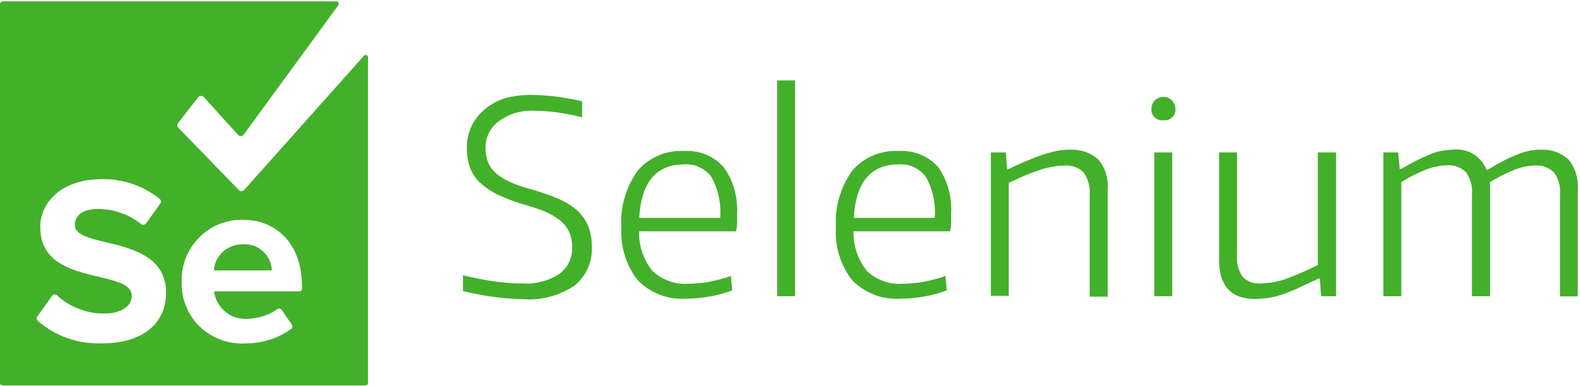
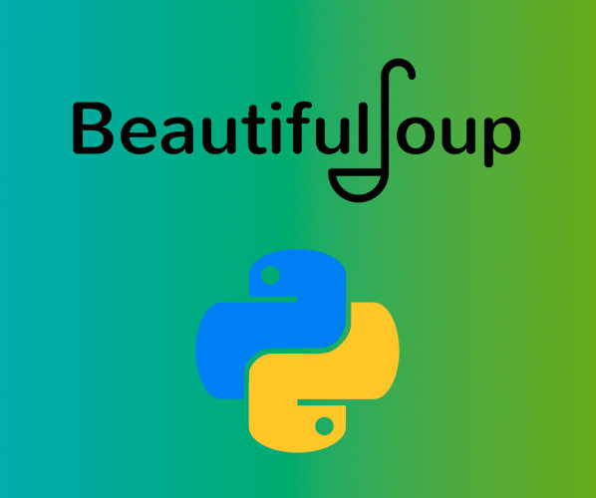
Why use Python?
Python is a popular choice for web scraping due to its ease of use and powerful libraries.
Libraries like Beautiful Soup and Selenium make it easy to parse HTML and interact with web pages.
This Photo by Unknown Author is licensed under CC BY-SA
This Photo by Unknown Author is licensed under CC BY-SA

Slide 4
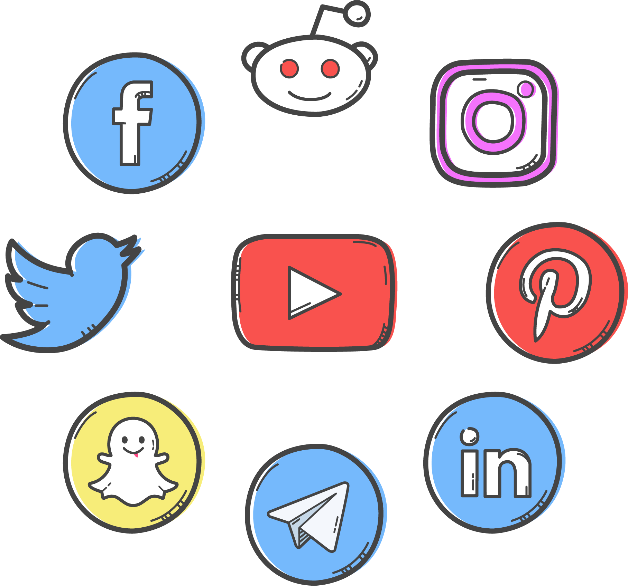
Web Scraping Applications
Web Scraping is used in various fields, from academic research to competitive business analysis.
Some examples include extracting product information (like my example), social media analysis, and gathering real estate listings.
This Photo by Unknown Author is licensed under CC BY-NC

Slide 5

Best Practices and Ethics in Web Scraping
Best Practices for Efficient and Safe Scraping:
Avoid making rapid, frequent requests to respect the target website’s bandwidth.
Identify your scraper as a bot to be transparent about your activities.
Implement robust error handling.
Ethical and Legal Considerations:
Respect the guidelines outlined in the website's robots.txt file.
Ensure scraping activities are compliant with legal regulations, including website terms of service and privacy laws.
Be mindful of privacy concerns, especially when dealing with personal data.

Slide 6
Demonstration

